Slide 1
rA
TEAM MEMBERS :
RA2211003011996
S GOKUL
RA2211003012002
J D MUTHUMANI
RA2211003012018
R LOKESHWARAN
TITLE :
Microprocessor based automatic attendance recorder ( make use of RFID : a unique for each student)

Slide 2

Revolutionizing
Attendance Tracking:
The Microprocessor- Based Automatic
At endance Recorder using RFID
Technology

Slide 3

Introduction
Attendance tracking is an essential part of any organization. The traditional process of taking attendance manually is time-consuming and prone to errors. The Microprocessor-Based Automatic Attendance Recorder using RFID Technology is a revolutionary solution that simpliﬁes attendance tracking and increases efﬁciency. This presentation will cover the features, beneﬁts, and implementation of this technology.

Slide 4
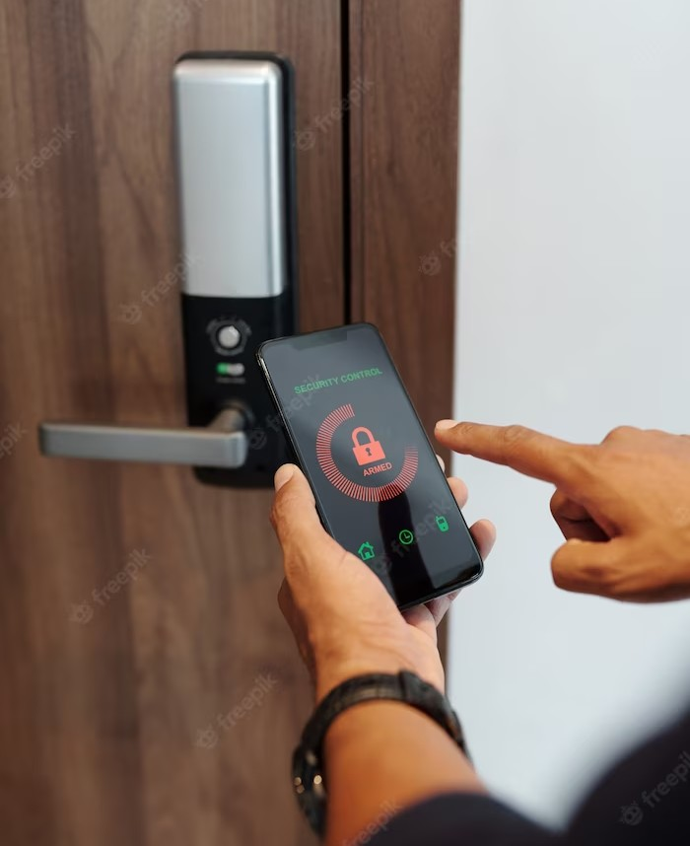
RFID Technology
Radio Frequency Identiﬁcation (RFID) is a wireless technology that uses radio waves to communicate between a reader and a tag.
The tag contains a unique identiﬁer that can be read by the reader. This technology is widely used in various applications such as inventory management, access control, and payment systems. In the context of attendance tracking, RFID technology offers a contactless and efﬁcient way of recording attendance.

Slide 5
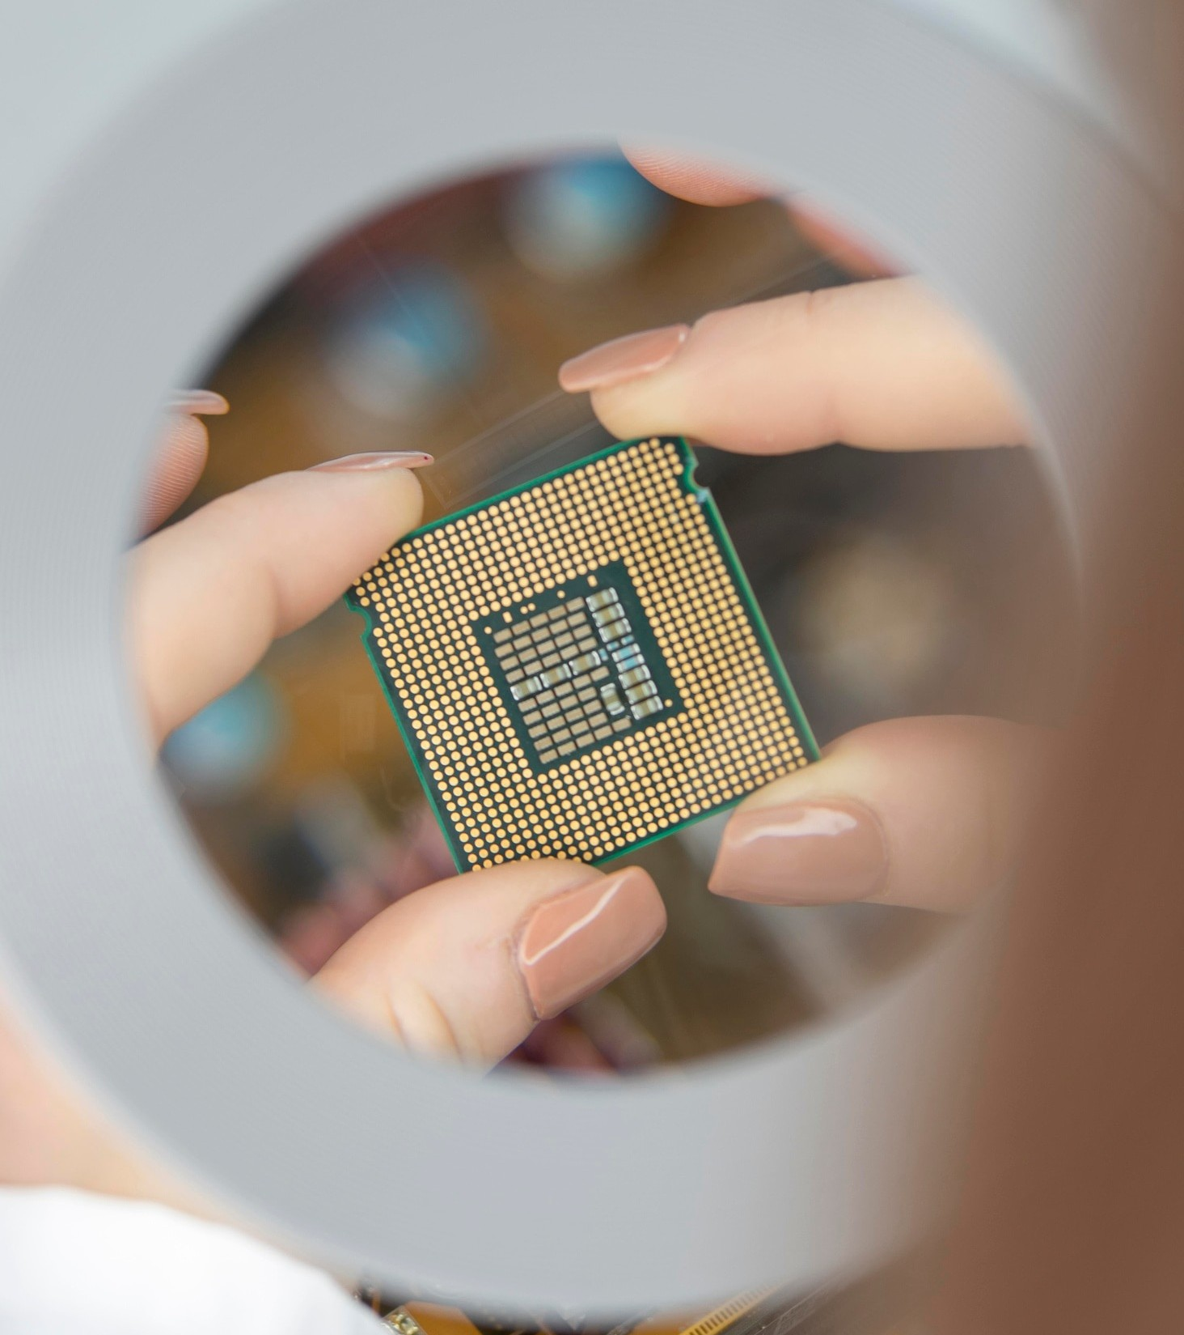
Microprocessor-Based System
A microprocessor is a small computer chip that can process data and perform calculations. The Microprocessor-Based Automatic Attendance Recorder is a system that uses a microprocessor to control the RFID reader and record attendance data. This system can be customized to meet the speciﬁc needs of an organization. It can store and analyze attendance data, generate reports, and integrate with other
systems.

Slide 6

Features
The Microprocessor-Based Automatic Attendance Recorder offers several features that make attendance tracking easier and more efﬁcient. These include: contactless attendance recording, real-time data collection, automated reporting, customizable settings, and secure data storage. These features eliminate the need for manual attendance taking, reduce errors, and provide accurate attendance records.

Slide 7

Beneﬁts
Implementing the Microprocessor-Based Automatic Attendance Recorder can provide several beneﬁts to an organization. These include: time-saving attendance tracking, reduced administrative workload, improved accuracy, enhanced security, and cost-effective solution. These beneﬁts can lead to increased productivity, better decision-making, and improved overall performance.

Slide 8
Conclusion
The Microprocessor-Based Automatic Attendance Recorder using RFID Technology is a revolutionary solution that can transform attendance tracking in any organization. It offers several features and beneﬁts that make attendance tracking easier, more efﬁcient, and cost-effective. By implementing this technology, organizations can improve productivity, accuracy, and overall performance. Thank you for your attention.

Slide 9
Thank YOU !

